Slide 1
Lesson 3.3
Oil Spill Response Preparedness
CGPRT(W) : Ensuring Clean Seas and Coasts in Western Region ……

Slide 2
Objective
To understand the requirements of the OPRC Convention.
To understand how to prepare to respond.
To understand the need for an efficient contingency planning system.
CGPRT(W) : Ensuring Clean Seas and Coasts in Western Region ……

Slide 3
Introduction
This lesson will cover:
An understanding of the cause and frequency of oil spills
The need for preparedness planning
The format and contents of an efficient contingency plan system
CGPRT(W) : Ensuring Clean Seas and Coasts in Western Region ……

Slide 4
Background Risk
Marine traffic presents the risk of marine oil pollution from:
Collisions
Groundings
Transfer of oil cargo and bunkers
Other marine accidents
Petroleum exploration and production provides further risk of pollution
CGPRT(W) : Ensuring Clean Seas and Coasts in Western Region ……

Slide 5
Background Risk
Such pollution can threaten a wide range of resources:
Ecological (e.g. sea-birds, wetlands)
Socio-economic (e.g. fisheries, tourism)
Archaeological/cultural
The response to such pollution requires careful advance planning
CGPRT(W) : Ensuring Clean Seas and Coasts in Western Region ……

Slide 6
Background Risk
Shipping transports 90% of global trade
a very powerful and positive force
making a major contribution to global trade and prosperity
a relatively small negative impact on the global environment
statistically, the least environmentally damaging mode of transport, when its productive value is taken into consideration
CGPRT(W) : Ensuring Clean Seas and Coasts in Western Region ……

Slide 7
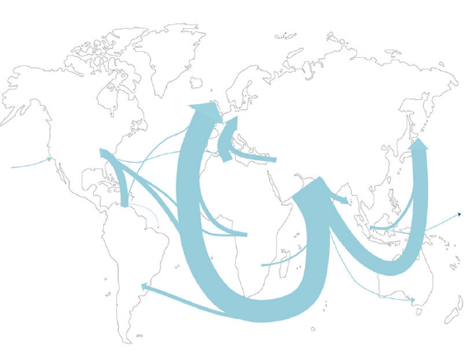
Crude Oil Seaborne Trade − 1973
Source: Fearnley’s
CGPRT(W) : Ensuring Clean Seas and Coasts in Western Region ……

Slide 8
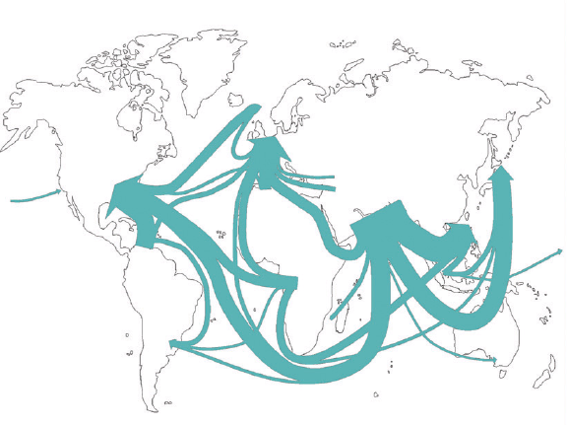
Crude Oil Seaborne Trade − 2002
Source: Fearnley’s
CGPRT(W) : Ensuring Clean Seas and Coasts in Western Region ……

Slide 9
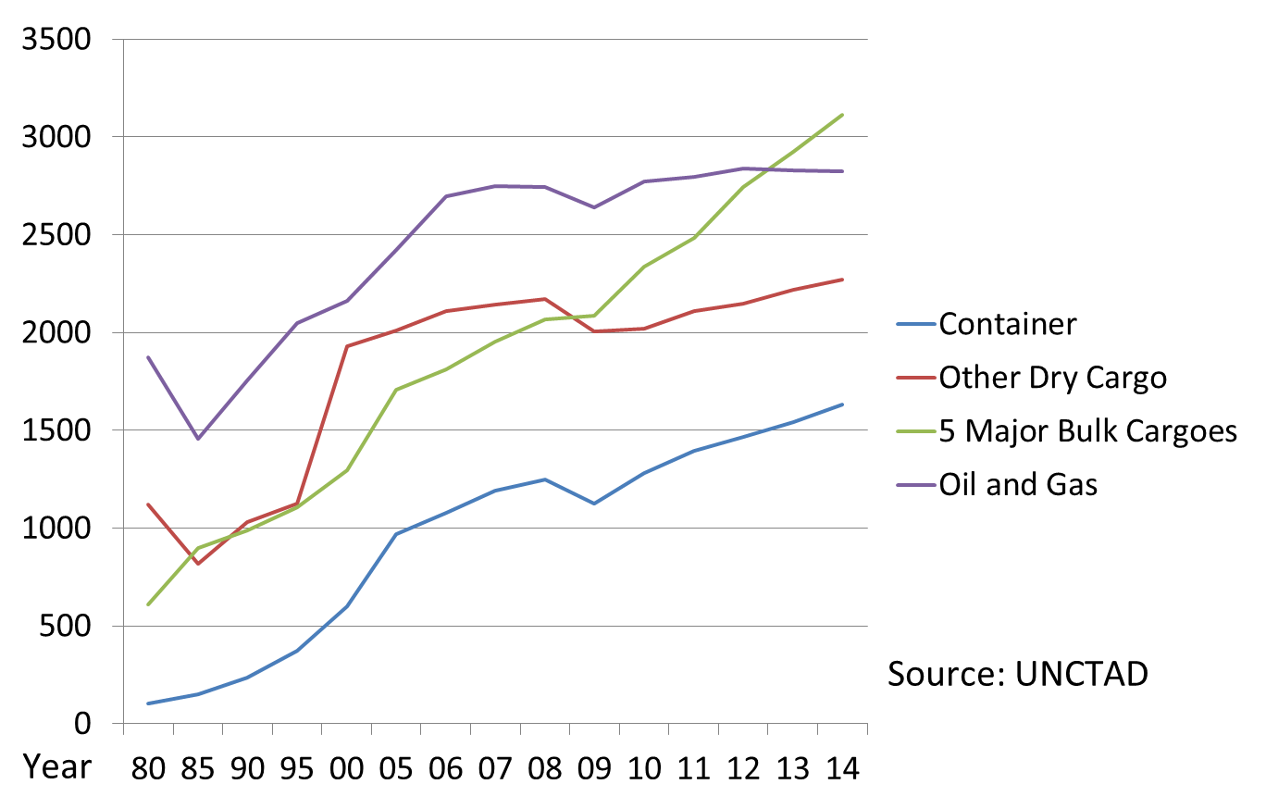
International Seaborne Trade
Million of tons loaded
CGPRT(W) : Ensuring Clean Seas and Coasts in Western Region ……

Slide 10
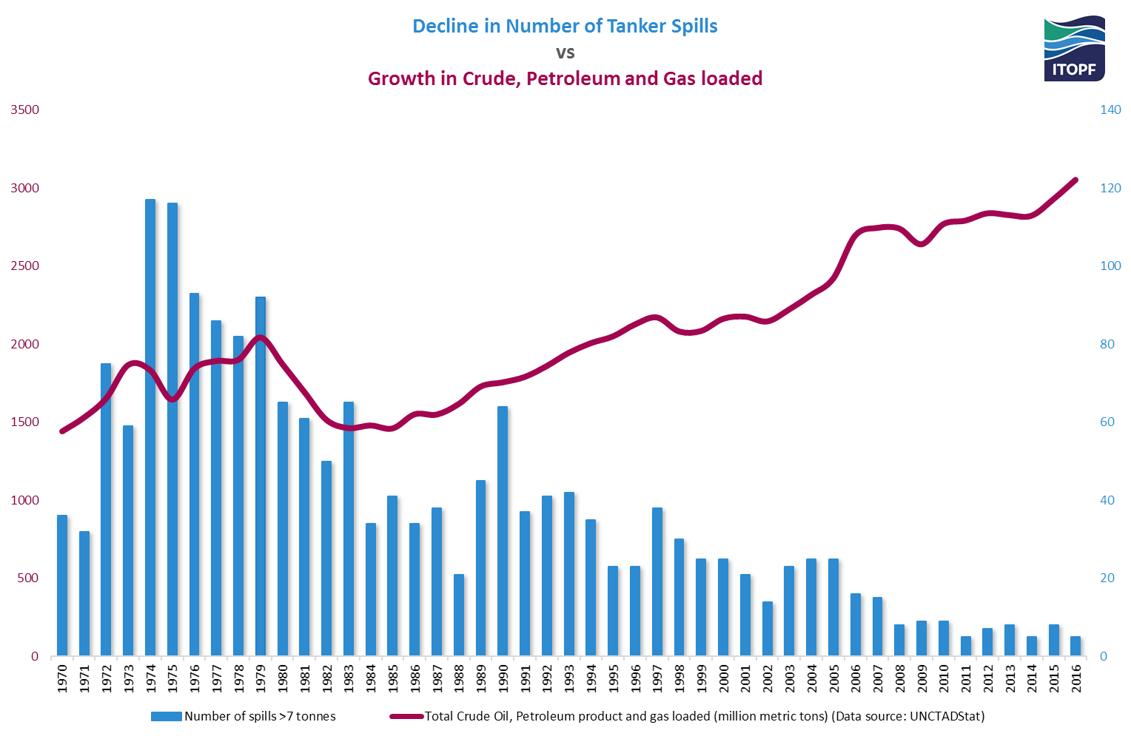
Seaborne Oil Trade and Oil Spills
CGPRT(W) : Ensuring Clean Seas and Coasts in Western Region ……

Slide 11
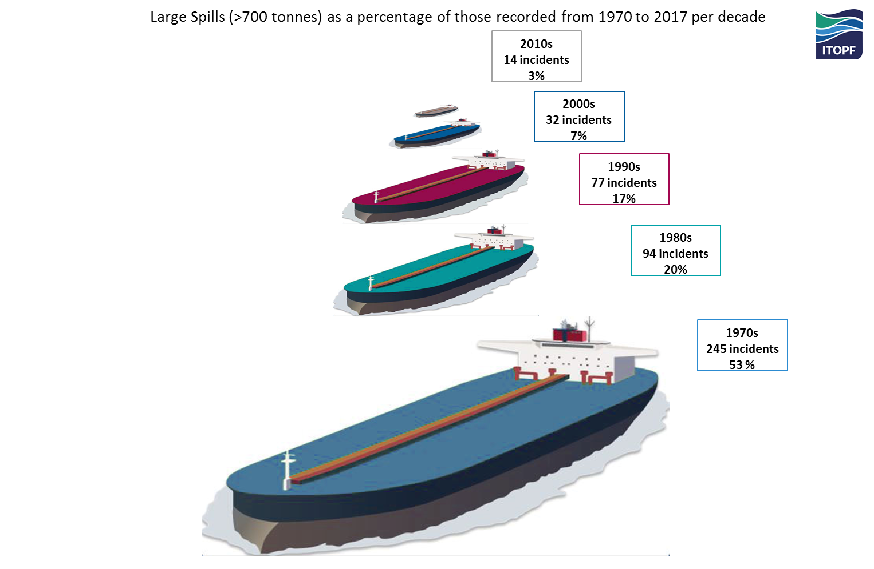
Large spills (> 700 tonnes) as a percentage of those recorded from 1970 to 2017 per decade
CGPRT(W) : Ensuring Clean Seas and Coasts in Western Region ……

Slide 12
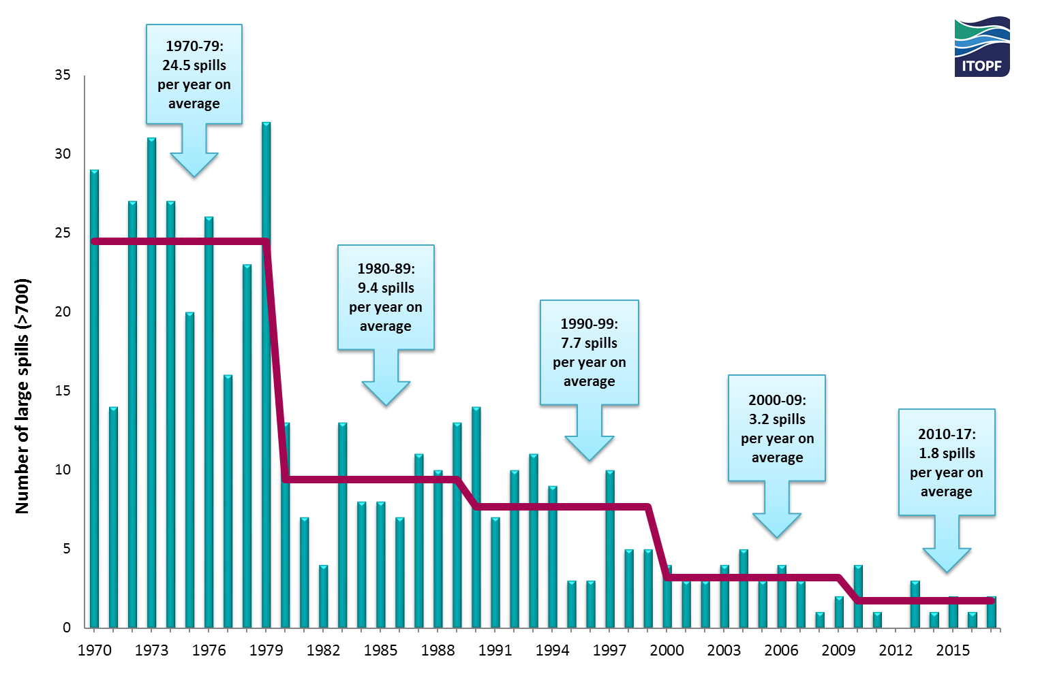
Number of large spills (> 700 tonnes) from 1970 to 2017
CGPRT(W) : Ensuring Clean Seas and Coasts in Western Region ……

Slide 13
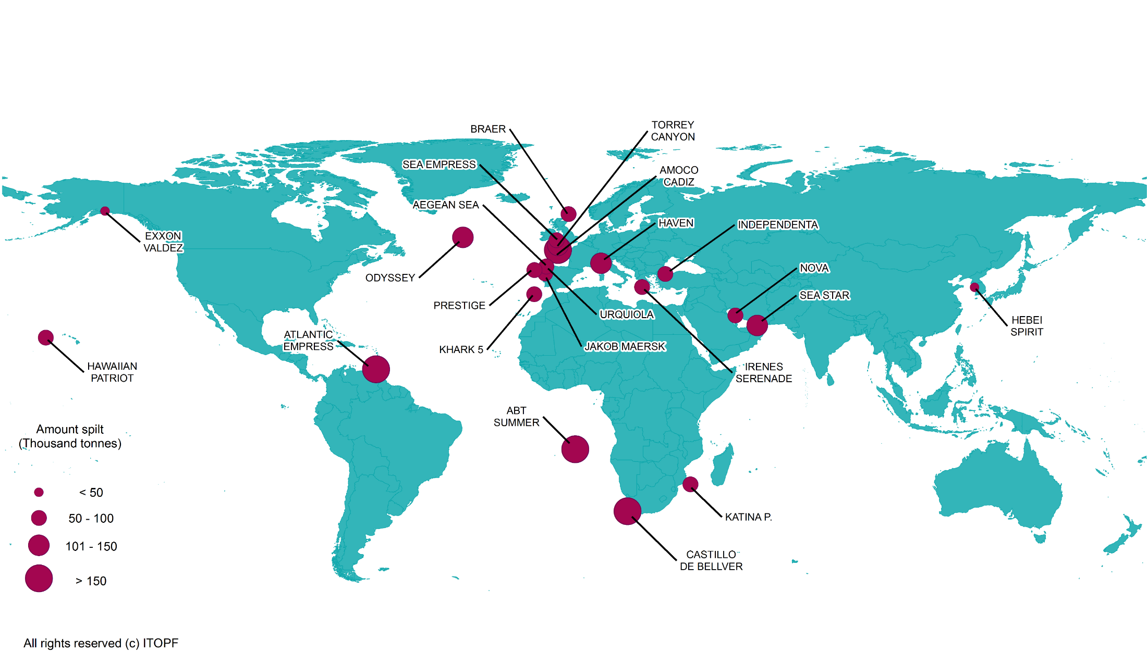
Location of Major Spills
ITOPF tanker spill statistics 1970−2017
CGPRT(W) : Ensuring Clean Seas and Coasts in Western Region ……

Slide 14
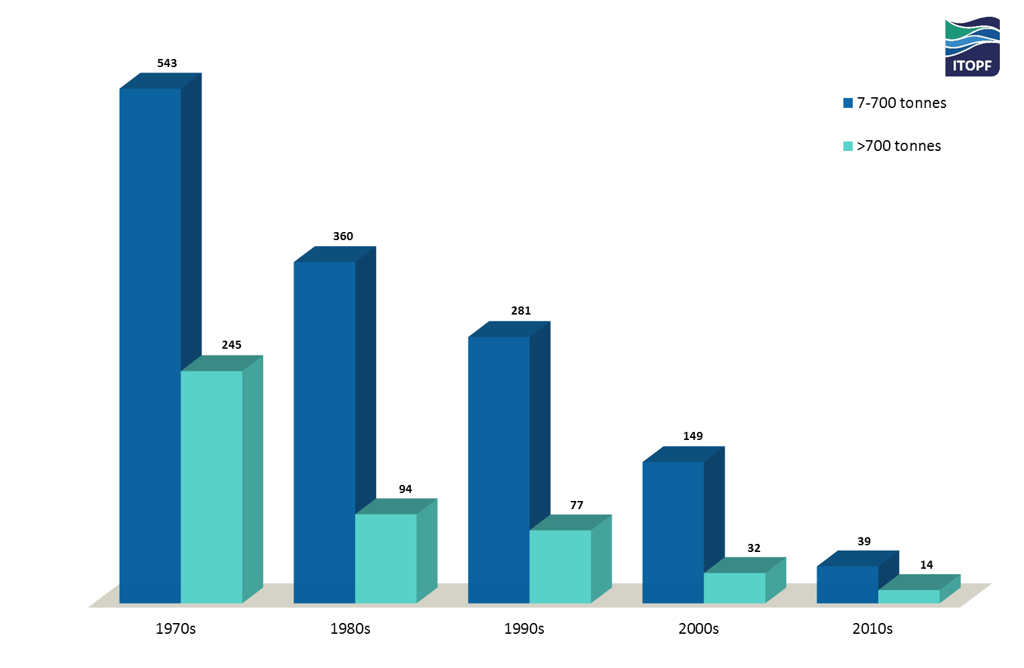
Number of medium spills (7 – 700 tonnes) and large
(> 700 tonnes) spills per decade from 1970 to 2017
CGPRT(W) : Ensuring Clean Seas and Coasts in Western Region ……

Slide 15
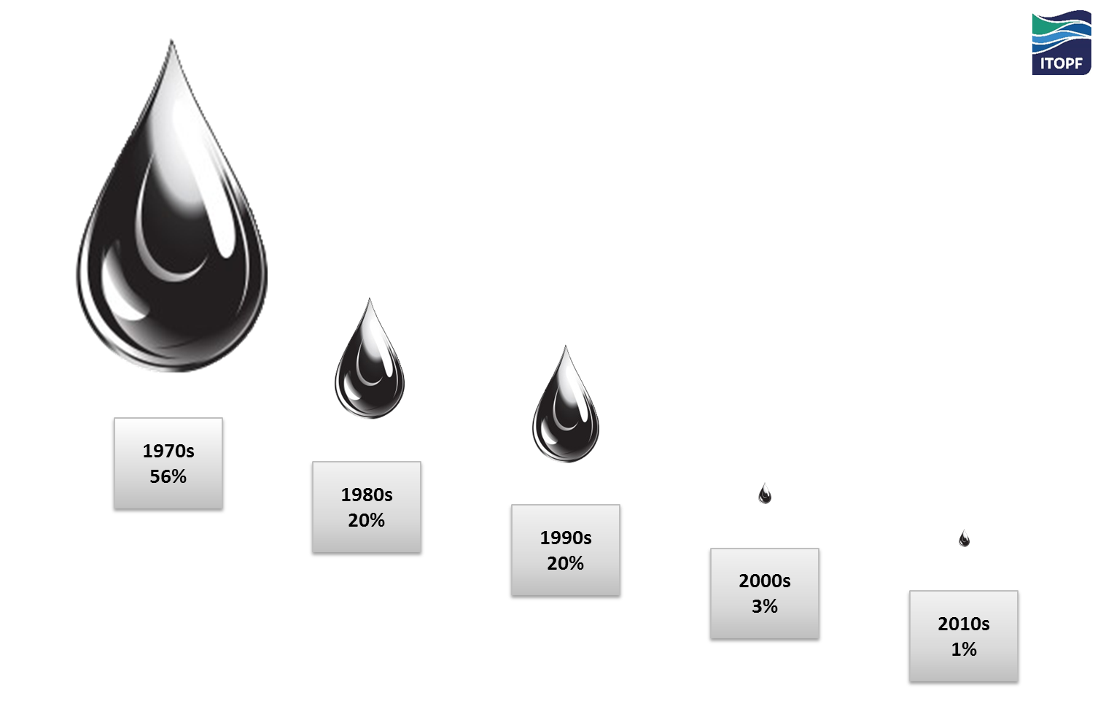
Oil spilt per decade as a percentage of the total spilt between 1970 and 2017
CGPRT(W) : Ensuring Clean Seas and Coasts in Western Region ……

Slide 16
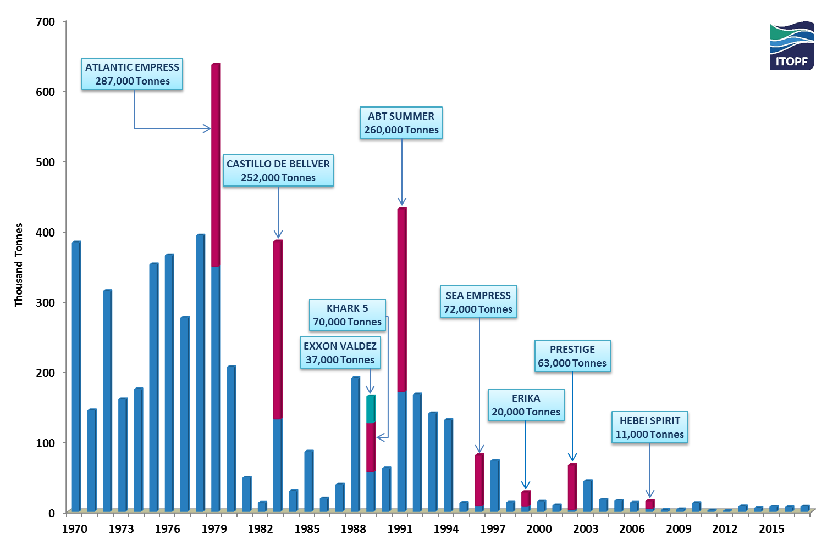
Quantities of oil spilt > 7 tonnes (rounded to nearest thousand), 1970 - 2017
CGPRT(W) : Ensuring Clean Seas and Coasts in Western Region ……

Slide 17
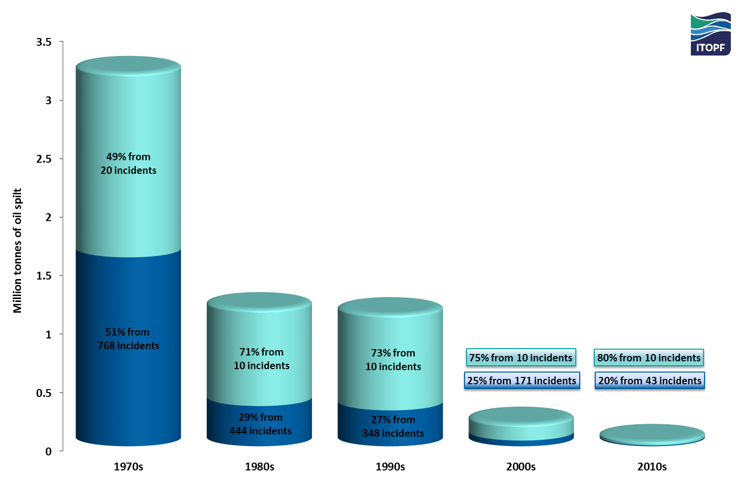
Spills > 7 tonnes per decade showing the influence of a relatively small number of comparatively large spills on the overall figure
CGPRT(W) : Ensuring Clean Seas and Coasts in Western Region ……

Slide 18
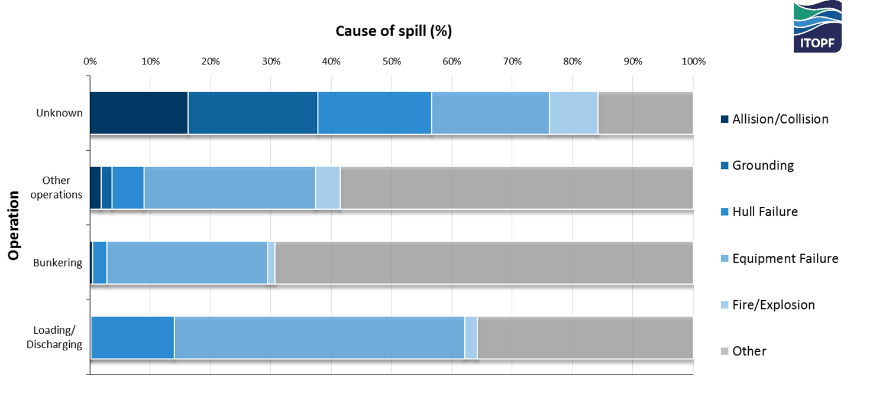
Incidence of spills < 7 tonnes by operation at time of incident and primary cause of spill, 1970 to 2017
CGPRT(W) : Ensuring Clean Seas and Coasts in Western Region ……

Slide 19
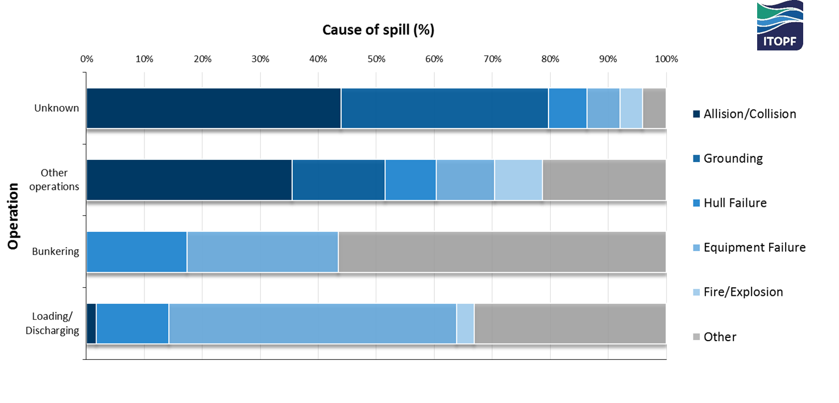
Incidence of spills 7–700 tonnes by operation at time of incident and primary cause of spill, 1970 to 2017
CGPRT(W) : Ensuring Clean Seas and Coasts in Western Region ……

Slide 20
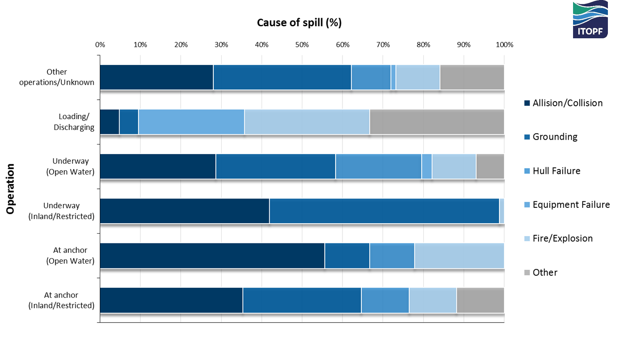
Incidence of spills > 700 tonnes by operation at time of incident and primary cause of spill, 1970 to 2017
CGPRT(W) : Ensuring Clean Seas and Coasts in Western Region ……

Slide 21
IMO Treaty Instruments
IMO has adopted 51 treaty instruments¹
23 are directly environment-related
Key amongst these is the OPRC Convention
  Global framework for international cooperation in combating major incidents or threat of marine pollution
Note 1: As at February 2013
CGPRT(W) : Ensuring Clean Seas and Coasts in Western Region ……

Slide 22
OPRC Convention − Benefits
Benefits to signatories include:
Access to an international platform for cooperation and mutual assistance and a mechanism for establishing cooperative arrangements with other Parties
A means for urgently accessing relevant technical assistance and response resources in the event of an incident
CGPRT(W) : Ensuring Clean Seas and Coasts in Western Region ……

Slide 23
OPRC Convention – Benefits
Benefits to signatories include:
A framework for the development of national and regional capacity to prepare for, and respond to, incidents
Participation in a network for the exchange of new research and development information, best practices and practical experiences in response.
CGPRT(W) : Ensuring Clean Seas and Coasts in Western Region ……

Slide 24
General IMO benefits
In addition all member States can:
Access training and support for developing the essential preparedness and response structures and legislation, at national and regional levels
through IMO's Integrated Technical Cooperation Programme
CGPRT(W) : Ensuring Clean Seas and Coasts in Western Region ……

Slide 25
OPRC Convention – Key Articles
Article | Description
3 | Oil pollution emergency plans
4 | Oil pollution reporting procedures
5 | Action on receiving an oil pollution report
6 | National and Regional systems for preparedness and response
7 | International cooperation in pollution response
CGPRT(W) : Ensuring Clean Seas and Coasts in Western Region ……

Slide 26
OPRC: Obligations of Parties
National system for responding promptly and effectively to oil pollution incidents:
A national contingency plan
Designated national authorities:
    Responsible for preparedness and response
    Operational contact point(s)
    Requesting and rendering assistance
CGPRT(W) : Ensuring Clean Seas and Coasts in Western Region ……

Slide 27
OPRC: Obligations of Parties
Establish individually or through bilateral or multilateral cooperation and, as appropriate, in cooperation with the oil and shipping industries, port authorities and any other relevant entities:
minimum level of pre-positioned equipment commensurate with risk
programme of exercises and training
plans and communications capabilities
mechanism for coordinating response
CGPRT(W) : Ensuring Clean Seas and Coasts in Western Region ……

Slide 28
OPRC: Pollution Emergency Plans
“Local” (oil) pollution emergency plans to be coordinated with national system for:
operators of offshore units
appropriate sea ports
appropriate oil handling facilities
+
flag ships of the Contracting Party
(also MARPOL requirement)
CGPRT(W) : Ensuring Clean Seas and Coasts in Western Region ……

Slide 29
OPRC: Reporting Requirements
To establish pollution reporting procedures for:
discharges from their own activities
any observed event at sea involving the discharge of pollution
reporting obligations on:
  flag ships, offshore units, sea ports, oil handling facilities, maritime inspection vessels or aircraft, civil aircraft
CGPRT(W) : Ensuring Clean Seas and Coasts in Western Region ……

Slide 30
OPRC: International Obligations
Obligation of Contracting Parties to:
Assess nature, extent and possible consequences of incident
Inform all States whose interests may be affected
Provide assistance if requested by another Party subject to capabilities and availability of relevant resources
CGPRT(W) : Ensuring Clean Seas and Coasts in Western Region ……

Slide 31
Purpose of a Contingency Plan
“A predetermined sequence of communications and actions which can be quickly initiated to cope with an event of possible but uncertain occurrence”
Provide a framework to respond to an oil spill or potential spill
Ensure that broad consensus has been achieved on response measures, prior to the incident
Meet or set legislative requirements
CGPRT(W) : Ensuring Clean Seas and Coasts in Western Region ……

Slide 32
Hierarchy of Contingency Plans
Preparation of detailed and specific plans
International level – bilateral or regional
National level – the strategic plan
Local level – the operational plans
  Ports, oil handling installations, offshore units, vessels
Plans to be coordinated under a national system
CGPRT(W) : Ensuring Clean Seas and Coasts in Western Region ……

Slide 33
Exercises
OPRC Article 6(2) also requires each party to establish:
a programme of exercises for oil pollution response organizations and training of relevant personnel
This should include the exercising of all components of your contingency plans
CGPRT(W) : Ensuring Clean Seas and Coasts in Western Region ……

Slide 34
Exercises
Purpose to test
  the plan
  the equipment
  the capabilities of the response team and the resources available to them
Guiding principles
  Ensure support for the activity at all levels of management
  Set clear, realistic and measurable objectives
  Evaluating the exercise effectively is as important as conducting it effectively
CGPRT(W) : Ensuring Clean Seas and Coasts in Western Region ……

Slide 35
Exercises
These exercises can include:
Notification exercise
  test the procedures to alert and call out the response teams via telephone or other means
Table-top exercise
  interactively discuss a simulated scenario among members of a response team without involving the mobilization of personnel and equipment
Equipment deployment exercise
  exercise deployment of oil spill response equipment at particular locations in response to an oil spill scenario
Incident management exercise
  simulate several different aspects of an oil spill incident with third parties who would actually be involved in a real emergency to test and train a whole response team
CGPRT(W) : Ensuring Clean Seas and Coasts in Western Region ……

Slide 36
Training
OPRC Article 6(2) also requires each party to establish:
a programme of exercises for oil pollution response organizations and training of relevant personnel.
This should include theoretical training at the appropriate level and include practical equipment deployment, as required
IMO OPRC Model Training Courses could be used as a guidance to plan and conduct a training
CGPRT(W) : Ensuring Clean Seas and Coasts in Western Region ……

Slide 37
Summary
We have considered:
the requirements of the OPRC Convention
how to prepare to respond
the need for an efficient contingency planning system backed up by training and exercises
CGPRT(W) : Ensuring Clean Seas and Coasts in Western Region ……

Slide 38
Any questions?
CGPRT(W) : Ensuring Clean Seas and Coasts in Western Region ……

